Slide 1

MICROCONTROLLERS
WORKSHOP PART ||
SMARTER TECHNOLOGY FOR ALL
2023 Lenovo Internal. All rights reserved.

Slide 2
SCHEDULE
TINKERCAD;
SIMULATE THE OPERATION OF A POTENTIOMETER (ANALOG PIN);
PRACTICE;
SIMULATE THE OPERATION OF A LED (DIGITAL PIN);
PRACTICE;
SIMULATE THE OPERATION OF A SERVO MOTOR (PWM FUNCTION);
PRACTICE;
BONUS QUESTION
2023 Lenovo Internal. All rights reserved.
2

Slide 3
TINKERCAD
Tinkercad is a free online tool for creating and designing 3D models, as well as simulating analog and digital electrical circuits.
* We used Fritzing to simulate electronic circuits.
2023 Lenovo Internal. All rights reserved.
3

Slide 4
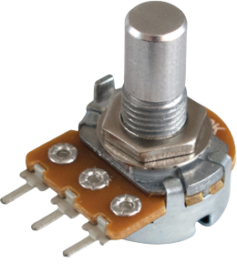
POTENTIOMETER
The potentiometer has adjustable electrical resistance and acts as a voltage divider.
2023 Lenovo Internal. All rights reserved.
4

Slide 5
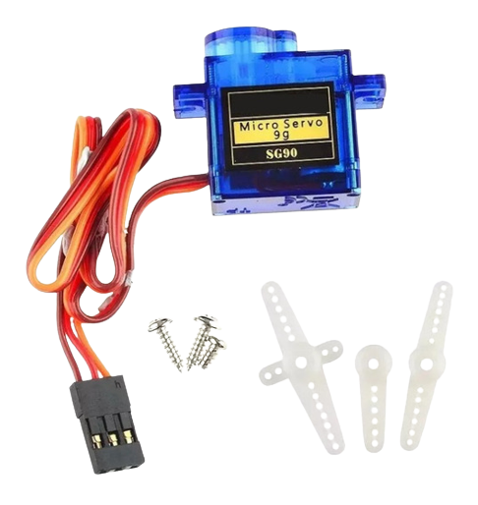
SERVO MOTOR 90°
The servo motor is an electromechanical actuator, which presents movement proportional to a command.
2023 Lenovo Internal. All rights reserved.
5

Slide 6
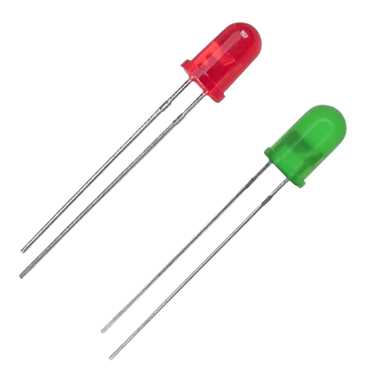
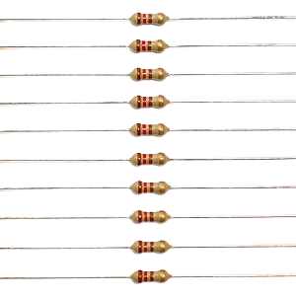
LEDS and RESISTORS
The LED is a light emitting electronic component (L.E.D = Light emitter diode), which has the property of transforming electrical energy into light.
2023 Lenovo Internal. All rights reserved.
6

Slide 7
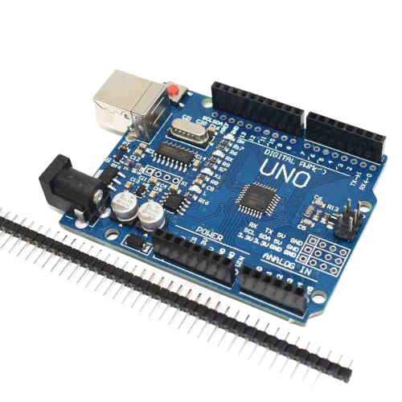
MICROCONTROLLER
Arduino is an open-source electronics prototyping platform
2023 Lenovo Internal. All rights reserved.
7

Slide 8
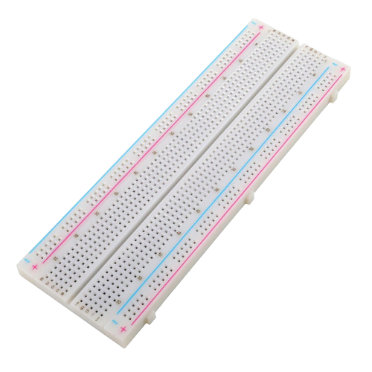
BREADBOARD
A breadboard is a board with conductive connections used to assemble prototypes and early-stage designs.
2023 Lenovo Internal. All rights reserved.
8

Slide 9
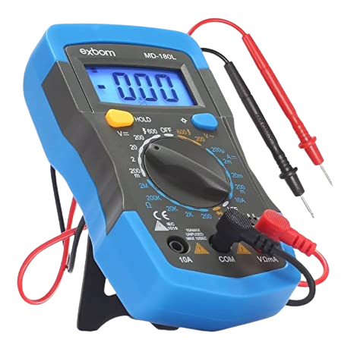
MULTIMETER
A multimeter is a device designed to measure electrical quantities.
2023 Lenovo Internal. All rights reserved.
9

Slide 10

2023 Lenovo Internal. All rights reserved.
10

Slide 11
BIBLIOGRAPHY
ELECTRONIC CIRCUIT SIMULATION SOFTWARE
https://www.tinkercad.com/
ARDUINO LANGUAGE REFERENCE
https://www.arduino.cc/reference/en/
DOWNLOAD OPTIONS (ARDUINO IDE 2.0.3)
https://www.arduino.cc/en/software
2023 Lenovo Internal. All rights reserved.
11

Slide 12
THANKS!
SMARTER TECHNOLOGY FOR ALL

